Slide 1
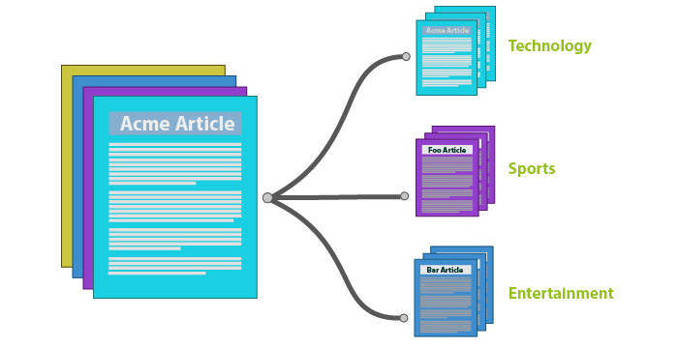
PHISHING DETECTION
UISNG
MACHINE LEARNING
PHISHING
…...EMAILS…..
SAFE
POTENTIAL

Slide 2
PROBLEM AIM
The main goal of this project is to create a machine learning model/ system that will be able to recognize and determine the label / Category of a email as phishing email or a safe emails using concepts like NLP and machine learning .

Slide 3
INTRODUCTION
PHISHING
Phishing is a form of cyber crime that focus on
Stealing valuable information like passwords,
Bank details , social security numbers or access to the device via some illegal methods.
Types :
Emails
URLs
SMS
spear
WHY ?
ON EMAILS
The most used method is Email phishing . Since most of the people use emails and have an email account , possibilities of finding some innocent and inexperienced is very high .

Slide 4
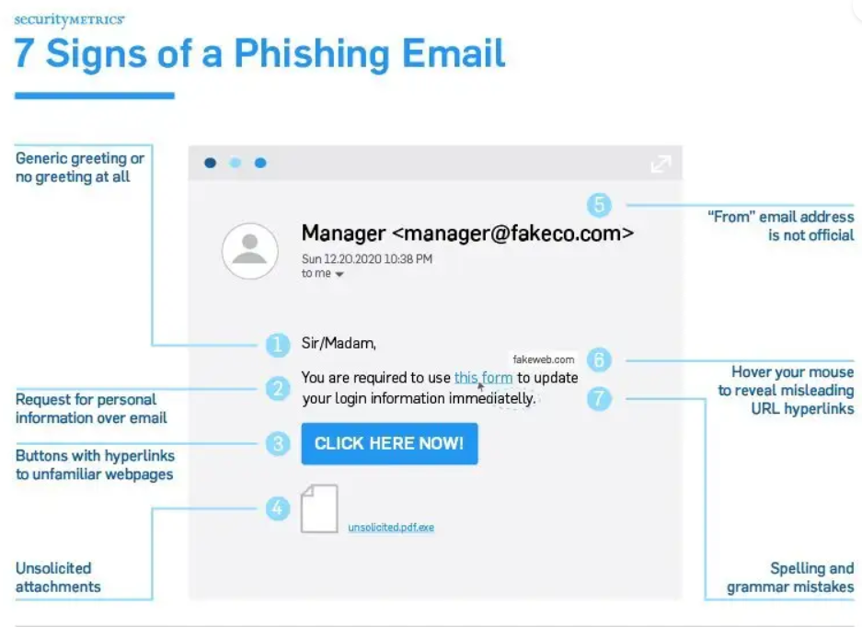
HOW ? APPROACH
NLP PART : I used NLP on the body of the email to learn from the language , presentation.
RULE-BASED : added some rules regarding mistakes , URLs and mails .

Slide 5
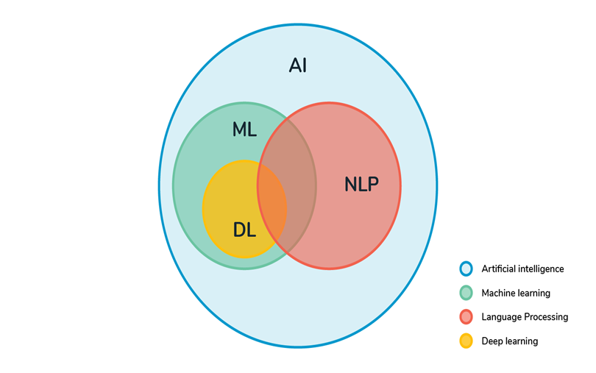
METHODOLOGY
DATA ACQUISITION
TEXT PREPROCESSING
DATA VISUALIZATION
LABEL ENCODING
TEXT VECTORIZATION
MODEL TRAINING
PREDICTION

Slide 6
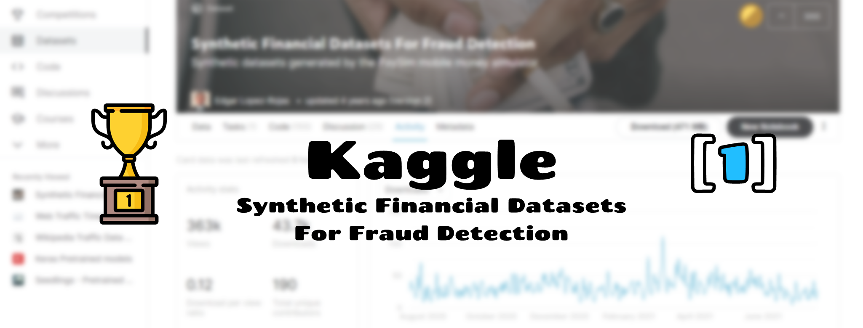
1 .DATA MINING

Slide 7
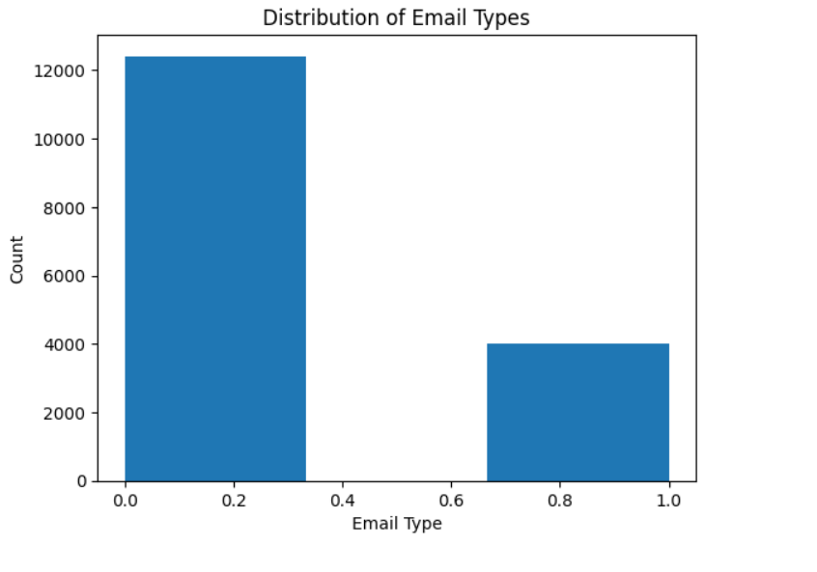
2 .DATA VISUALIZATION
2 | 5

Slide 8
3. TEXT PREPROCESSING

Slide 9
4 . LABEL ENCODING
Since computer cannot understand human language the categories/label used need to be encoded , hence some unique code or number is given to identify the label .
Although this can be done very easily I had already converted my binary labels to numbers .

Slide 10
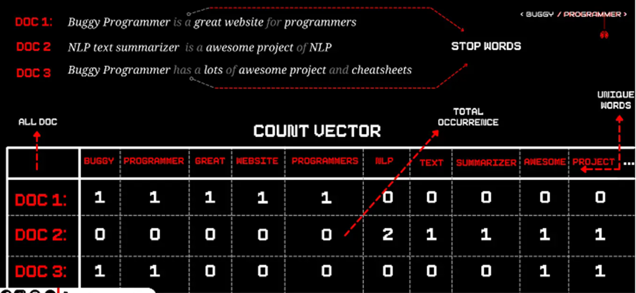
CORPUS .
DOCUMENTS
4 . TEXT VECTORIZATION
VOCABULARY

Slide 11
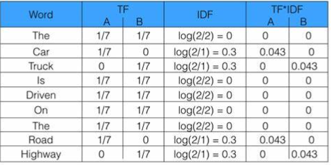
TEXT VECTORIZATION
1
ONE HOT ENCODING
Creating a vector of V dimensional vector with binary digits.
2
BAG OF WORDS / N-GRAMS
Creating a vector of V dimensional vector with frequency digits.
3
TF – IDF
Based on term frequency and inverse document frequency

Slide 12

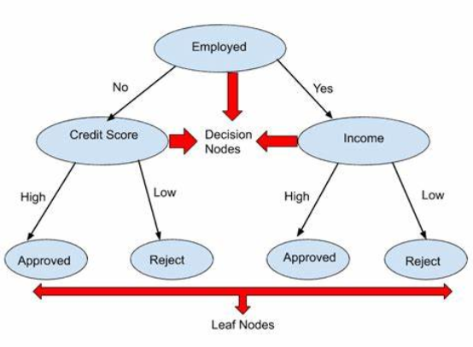
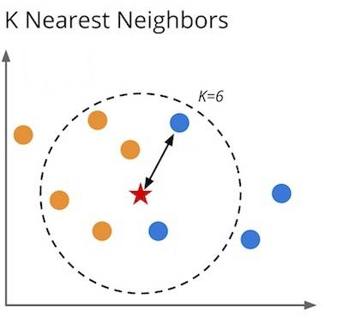
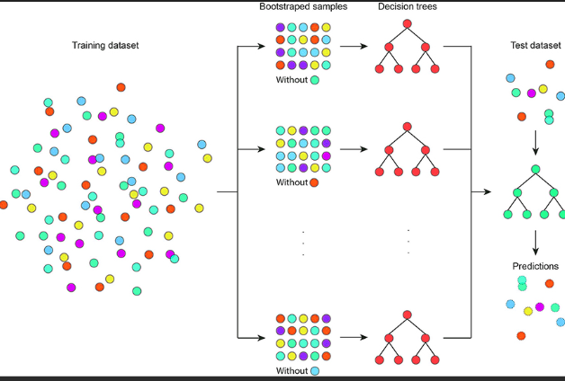
6. MODEL TRAINING
-Popular Machine Learning Algorithms for Text Classification
DECISION TREE
K-NN
RANDOM FOREST
A probabilistic classifier group that uses Bayes' theorem
It is called naïve because of its assumptions
That features are independence.
A powerful algorithm that find the categories
of data based on the data of K classes nearest.
The classes are divided by a hyperplane / line
which tries to maximize the margin between the
support vectors
This Photo by Unknown Author is licensed under CC BY-SA

Slide 13
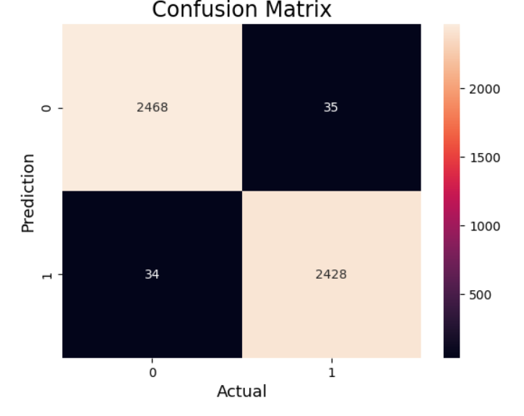
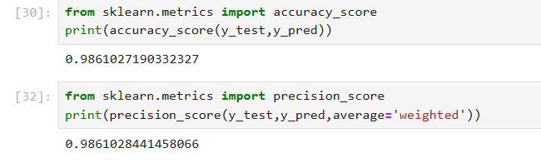
7. PREDICTIONS
Classification matrices are used to evaluate the accuracy .
ACCURACY
MATRIX
CONFUSION MATRIX
.

Slide 14
GUI
FUTURE WORK
For future work several factors can be considered :
Dataset : better dataset can be found with different aspects of phishing , like the url , body , headers this will ensure greater accuracy and effectiveness combine with our model.
OOV’s : Although accurate , machine learning algorithms are still susceptible to Out Of Vocabulary ,there are several steps that can be used to reduce OOVs from a model , this will ensure grater accuracy with the data that our model has never encountered before.
NN : Although accurate , machine learning algorithms are still not as accurate as Neural Network based NLP , so expanding this project to NN will gave greater results.
DATA NAME
DATA NAME
37%
10%
+5 (10%)
-32 (10%)
DATA NAME
DATA NAME
67%
12%
60%
+25%
+5 (10%)
-22 (10%)

Slide 15
THANK YOU

